Slide 1



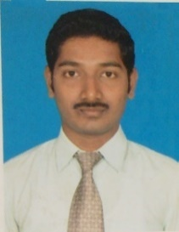
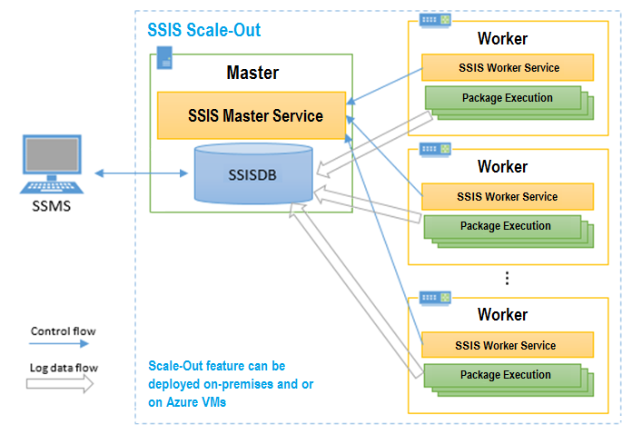
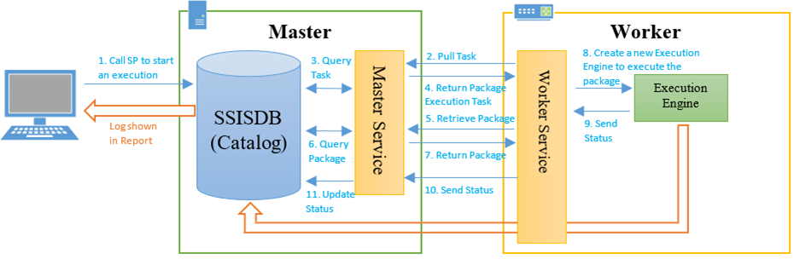
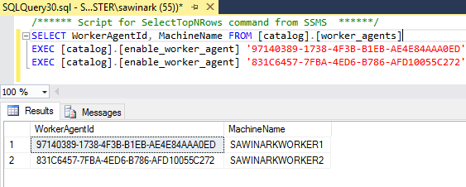
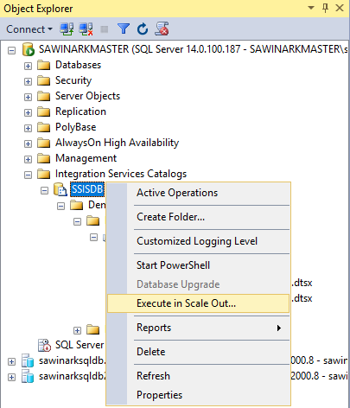
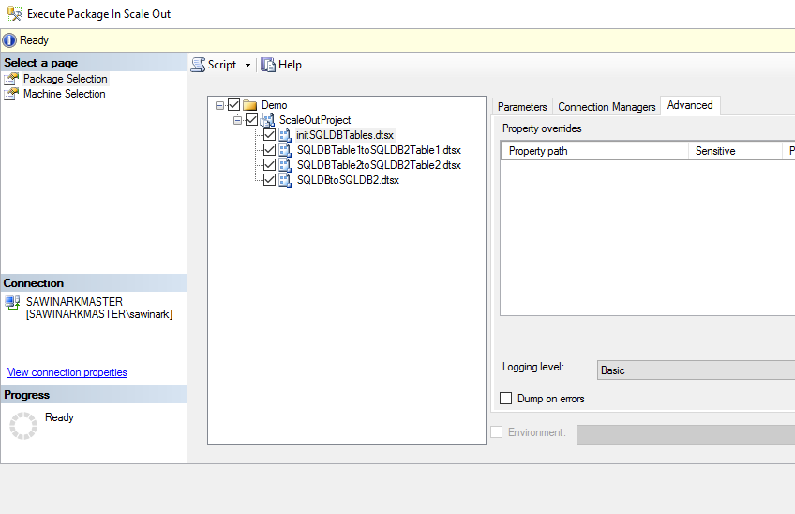
Master Data Management
Microsoft BI-focal lens
SQL Server vNext – Scale out feature
Purpose : Reduce ETL execution time using a scale-out solution on premises and in the cloud that can be managed / monitored with familiar tools
Nagaraj Sengodan has around 11 years of core work experience in DW/BI practice. He performed advisory role on complex Business Intelligence projects and architected Business Intelligence solutions and led the development of comprehensive dashboards, analytical reports.
The overall execution time of ETL workflows per customer across the industry keeps increasing due to:
Increasing number of packages
Increasing data volume from various sources
Increasing complexity in transformation tasks
.
Sample Picture/Screenshot
Scale-Out Master hosts SSISDB and Master Service
Scale-Out Worker hosts Worker Service and SSIS engine
Master Service manages Scale-Out operation by distributing packages to Worker Service
Worker Service initiates SSIS engine to execute packages locally in parallel
These Windows services communicate securely over SSL
Scale-Out Master Installation
Specify the port (8391 by default) and SSL server certificate for Master – Worker communications
Create a default, self-signed server certificate or select an existing server certificate
Scale-Out Worker Installation
SQL Server DB Engine needs not be installed and select just ”Scale Out Worker”
Select Windows account to start Worker Service and its start-up method
By default, a new account is created to start Worker Service automatically
Run packages with Execute Package In Scale Out dialog
### Open the Execute Package In Scale Out dialog box ### In SQL Server Management Studio, connect to the Integration Services server. In Object Explorer, expand the tree to display the nodes under Integration Services Catalogs. Right-click the SSISDB node or the project or the package you want to run, and then click Execute in Scale Out.
This content has been created by BAS – Microsoft Practice – powered by Microsoft Special Interest Group.
For any queries or nominations please write to bas.microsoft@hcl.com or elayaraja.e@hcl.com or sudripta.rakshit@hcl.com

